Slide 1
Strange Way to
Save the World

Slide 2
Note: After you download the slideshow, you may also need to download some videos from YouTube & add them into this PowerPoint. This tool can help you: Free YouTube Download
We present these messages in outdoor venues using the SonShineTent. Watch the video of our service that goes with this message, click here: http://campaignkerusso.org/?p=13464
We would love to know more about the people who download our lessons & sermons. We invite you to email us & let us know where & how you use them.
info@campaignkerusso.org

Slide 3
Welcome All

Slide 4
Let’s Begin with Prayer

Slide 5
Strange Way to
Save the World

Slide 6
When we think of a royal baby, we might think of something like this. But, God had another idea.

Slide 7
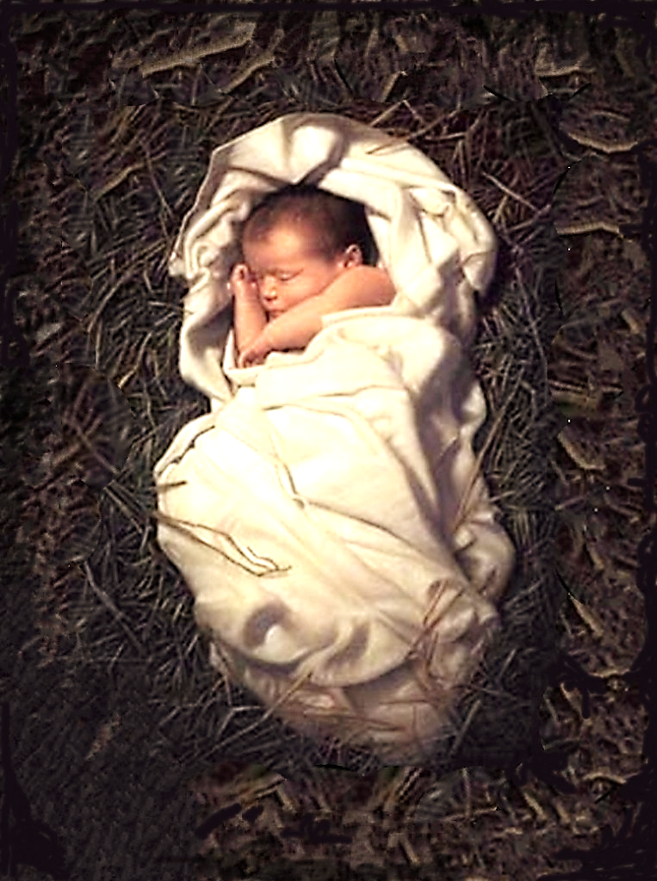
God’s idea of greatness is quite different than ours.

Slide 8
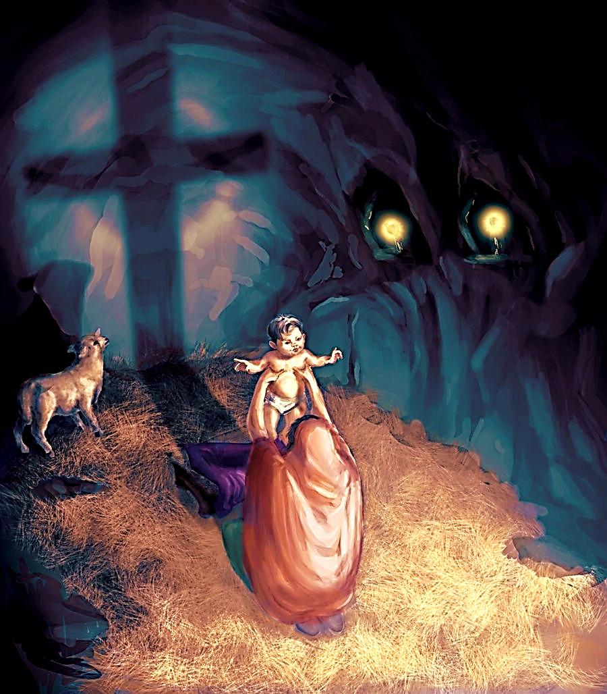
“For the foolishness of God is wiser than men, and the weakness of God is stronger than men.”
I Cor. 1:25

Slide 9
God chose a simple carpenter.
Why me, I’m just a simple man of trade?

Slide 10
“…an angel from the Lord came to him in a dream. The angel said, “Joseph, the baby that Mary will have is from the Holy Spirit. Go ahead and marry her.
Then after her baby is born, name him Jesus, because he will save his people from their sins.” Mat. 1:20-21

Slide 11
As he pondered the angel’s message, Joseph may have thought:
“I’m not one to second-guess angels, but this is such a strange way to save the world.”

Slide 12
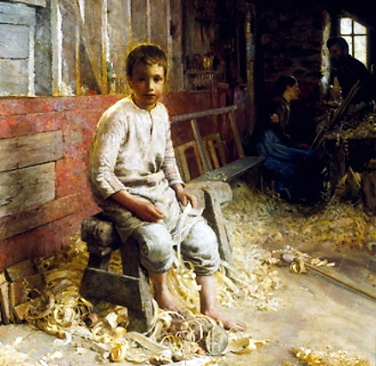
One day people would mock Jesus saying,
“… Is not this the carpenter's son? is not his mother called Mary?.. And they were offended in him”
Mat 13:55

Slide 13
God chose a weak infant.
Why Him, with all the rulers in the world?

Slide 14
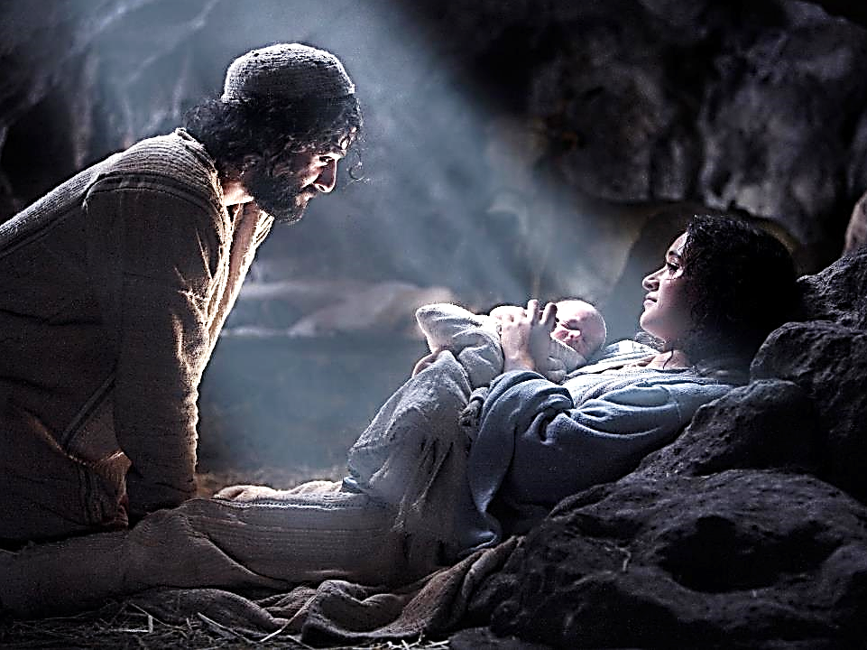
“And this will be a sign to you: You will find a baby wrapped in swaddling cloths and lying in a manger.” Luke 2:12
What’s that a sign of ?
Not strength!
An utterly, completely helpless baby…
Weakness !

Slide 15
God chose a dirty stable in a tiny town
Why here, inside this stable
filled with hay?

Slide 16
God chose the lowly things.
“ The Lord says, “Bethlehem Ephrathah, you are one of the smallest towns in Judah, but out of you I will bring a ruler for Israel…” Micah 5:2

Slide 17
No palace for this ruler,
just a pile of hay for a bed…

Slide 18
God chose a single pregnant girl
Why her, she’s just an ordinary girl?

Slide 19
She was an unmarried pregnant girl: despised.
She was a virgin, yet pregnant,
An impossible situation…
The things which are NOT, (this can’t be!)…
bringing to nothing the things which are.

Slide 20
Why me, I’m just a simple man of trade?

Slide 21
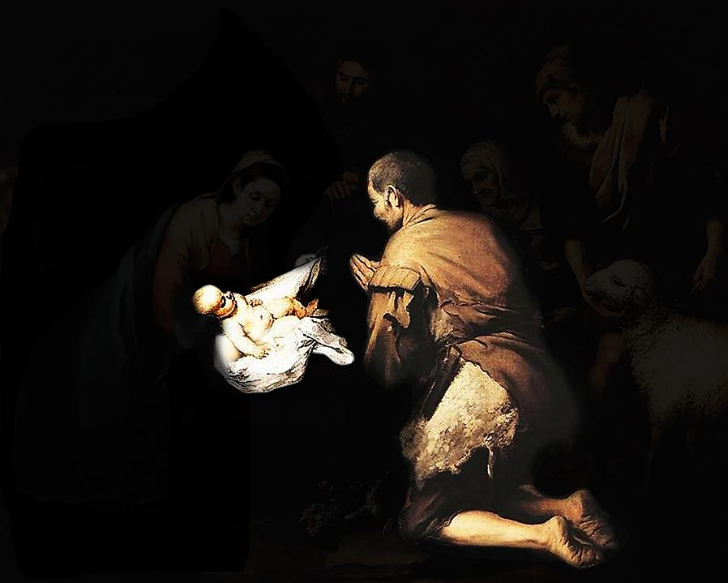
Why Him, with all the rulers in the world?

Slide 22
Why her, she’s just an ordinary girl?

Slide 23
Why here, inside this stable filled with hay?

Slide 24
This is such a strange way to save the world

Slide 25
Song: Strange Way to Save the World
Video Goes Here Title: Strange Way to
Save the World Download Here:
https://youtu.be/JKF7ybqRyy8

Slide 26
Is Jesus
Speaking to You?
“They said to each other, ‘Did not our hearts burn within us while he talked to us on the road, while he opened to us the Scriptures?’”
John Wesley Said:
“…the preacher was describing the change which God works in the heart through faith in Christ and I felt my heart strangely warmed.”
Jesus makes His presence Known by a small voice!

Slide 28
What is the Sinner‘s Prayer?
This is a prayer we can pray when we are ready to admit we are sinners and need Christ’s forgiveness.
It must be prayed with faith in our hearts and a readiness to have a life-changing encounter with Jesus Christ.

Slide 29
A prayer of faith → Pray this prayer if :
If you never have before
You have in the past, but you think it would mean more today
You have been walking afar off and you want to come back
You want to set an example & show others how it is done
You just like to give your heart to Jesus again & again
Faith

Slide 30
We Declare Our Faith Publicly Because Jesus Declared His LOVE Publicly
“If you stand before others and are willing to say you believe in me, then I will tell my Father in heaven that you belong to me.” Mat 10:32

Slide 31
Three Important Questions
Do you want to know Jesus as your Savior right now?
Do you believe He died to save you from your sins & that He rose from the dead?
Do you believe that He is here, waiting to save you right now?

Slide 32
The Prayer of a Sinner Turning to Jesus
Dear Jesus, I know that I have sinned against You and that my sins separate me from You.
I am truly sorry.
Right now, I turn away from my sinful past .
Please forgive me, and help me to keep from sin.
I believe You died for my sins.
I Believe You rose from the dead, you are alive, and you hear this prayer from my heart.
I invite You Jesus to be both my Savior and the Lord of my life.
I want You to rule my life from now on.

Slide 33
“But some people did accept him. They believed in him, and he gave them the right to become children of God.”
John 1:12

Slide 35
“If you openly say, ‘Jesus is Lord’ and believe in your heart that God raised him from death, you will be saved.”
Rom. 10:9
What did you learn today?
What about the strange way God saved the world?
What have you been thinking about God lately?
What do you want to tell others about Jesus?

Slide 36
Let’s Close in Prayer

